Slide 1

Handwritten Nepali Digit Classification
Presented by:
Aashish Pokharel (20786/075)
Milan Chaudhary (20811/075)
Shreedhar Ghimire (20827/075)
< 10 MP Session Title >
<First Name Last Name>
<First Name Last Name>
<Date>
17 April 2023

Slide 2
Phases of Project Outline
Introduction
Objectives
System Analysis
System Design
System Implementation
Conclusion

Slide 3
Introduction
Handwritten Nepali Digit Classification is the process to provide the ability to machines to recognize human handwritten digits
It is not an easy task for the machine because handwritten digits are not perfect, vary from person-to-person, and can be made with many different flavors
The project intends to implement a Feedforward Neural Network that will be able to recognize the handwritten digits with high accuracy

Slide 4
Objectives
Following are the objectives of the system:
To identify Nepali digits using Deep Learning Approaches,
To perform tasks such as hyperparameter tuning, normalization, regularization, etc. to create an efficient model,
To integrate the developed model into a given system where user can provide the input and the model gives the predicted outcome.

Slide 5
Scope & Limitation
The project tries to implement a system that will be able to take inputs from user and recognize which nepali digit is given as input.
The System has following limitations:
The system will not be able to recognize Nepali characters other than the digits

Slide 6
System Analysis

Slide 7
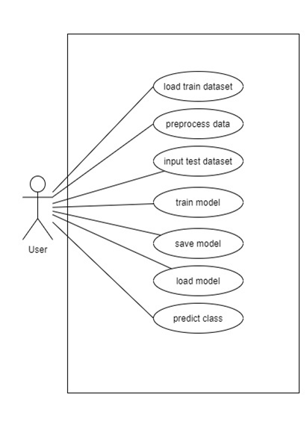
Functional Requirement :Use case Diagram

Slide 8
Data Analysis
Data for Each label : 2000 (85% train 15% test)
Image format : 32 * 32 pixels
Are all data of same shape ? Yes
Color Channels : 1

Slide 9
SYSTEM DESIGN

Slide 10
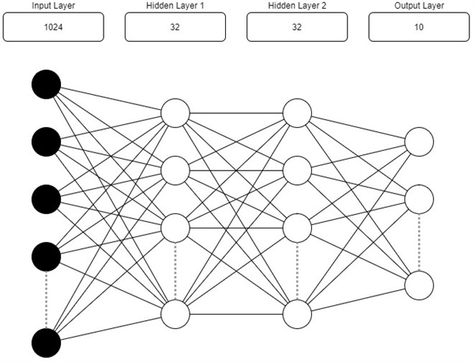
Model Architecture

Slide 11
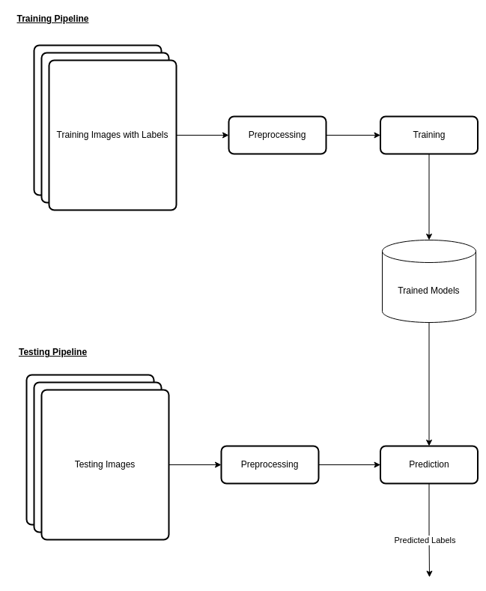
Model Building Pipeline

Slide 12
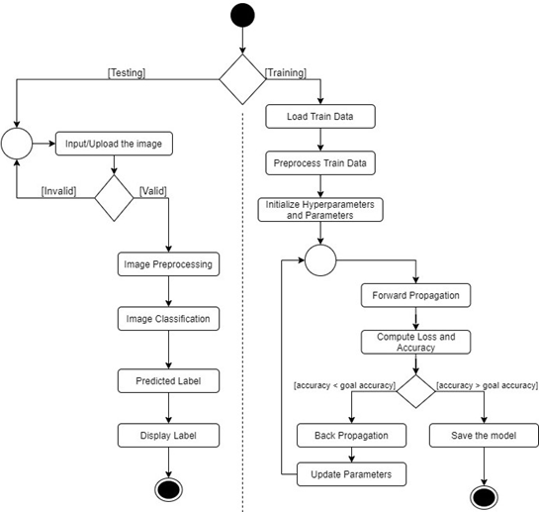
Activity Diagram
Fig: Activity Diagram

Slide 13
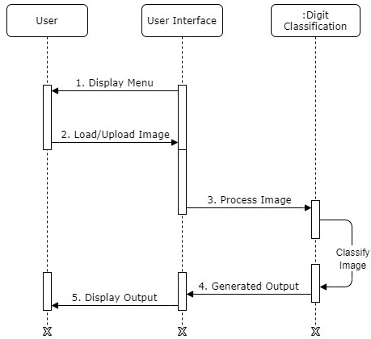
Sequence Diagram
Fig: Sequence Diagram for image Prediction

Slide 14

UI Design

Slide 15
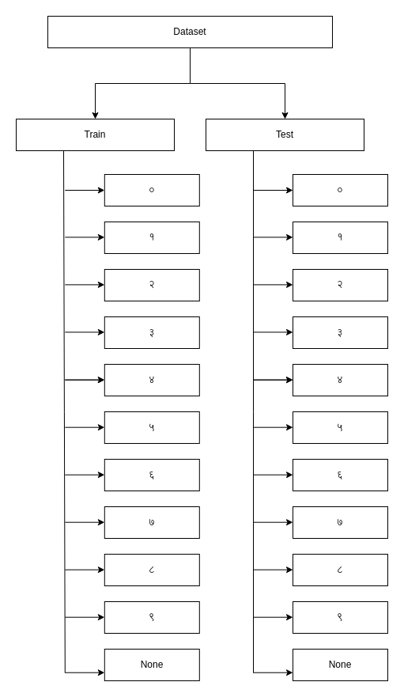
Data Organization : Folder structure
Dataset divided into:
Train
Test
Data stored in each of their labels

Slide 16
System Implementation

Slide 17
Development Tools Used
Anaconda
Jupyter Notebook
Visual Studio Code
Python
HTML/CSS
JavaScript
Git and Github

Slide 18
Design and Documentation Tools
Diagrams.net
Ms Word
Ms Powerpoint & Google Slides
Figma

Slide 19
Design Dependencies
NumPy
Matplotlib
Pickle
Pillow
React

Slide 20
Methodology

Slide 21
Methodology : Data Preparation
The data for training collected were in the image (*.jpg) format and were later converted into the dataframe for simplistic view.
The 32 * 32 images were converted into a 1-D array and appended as a row in the dataframe. The last column contains the label of the images.

Slide 22
Base Modelling : Architecture
Input layer shape : Input layer will consist of 32 * 32 image stacked into a single vector
Hidden Layers : Model will consist more than 2 hidden layers with 64 neurons each
Output Layers : Will output 10 possible outcomes, 10 for every Nepali digit
Learning Rate : 0.01
Activation function : relu

Slide 23
Base Modelling : Outcomes
Training Accuracy : 90%
Test Accuracy : 87%

Slide 24
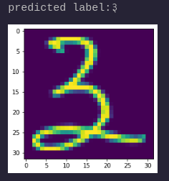
Base Model : Prediction Sample

Slide 25
Final Model
Fully connected neural network with 2 hidden layers.
Uses the He-initialization for weight initialization and L2 regularization for regularization.

Slide 26
Final Model : Architecture
The Final Model is a fully connected neural network with 2 hidden layers.
The final model uses the He-initialization for weight initialization and L2 regularization for regularization.

Slide 27
Final Model : Architecture
Properties | Values | Remarks
Hidden Layers | 2
Layer Sizes 1. Input Layer 2. Hidden Layer (1) 3. Hidden Layer (2) 4. Output Layer | 1024 32 32 10 | With ReLU Activation With ReLU Activation With Softmax Activation

Slide 28
Final Model : Architecture
Learning Rate | 0.01
Optimizer | Batch Gradient Descent
Iterations | 10000

Slide 29
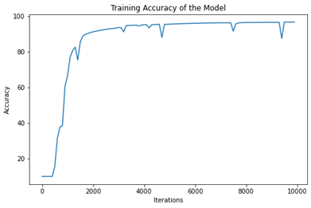
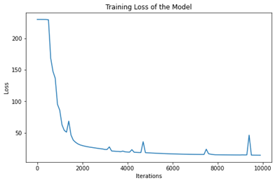
Final Model : Training Accuracy & Loss

Slide 30
Final Model : Performance
Accuracy: 1. Train 2. Test | 95.6% 94.5%
Precision 1. Train 2. Test | 95.2% 94.8%
Recall 1. Train 2. Test | 95.2% 96.5%

Slide 31
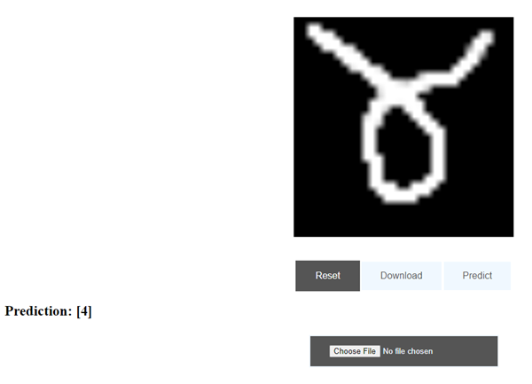
Final Model : Deployment

Slide 32
Final Model : Testing
Tests Performed:
Tests for classification
Tests for Network Initialization

Slide 33
Conclusion & Future Enhancements
The model although being simple architecture performs very well in the given scenario of digit recognition
Enhancements:
Fast and Powerful techniques such as CNN could be used

